Slide 1
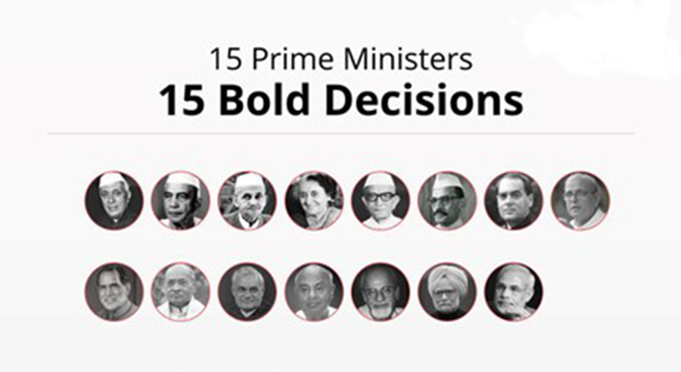
PRIME MINISTERS OF INDIA
Image credit_[1]
Capt.VEDANTA NAIR
TUSHAR JAGTAP
YASHMAN SINGH
JUGAL KUMAR
CHIRAG NAGPAL
Exploratory Data Analysis on prime ministers of INDIA

Slide 2
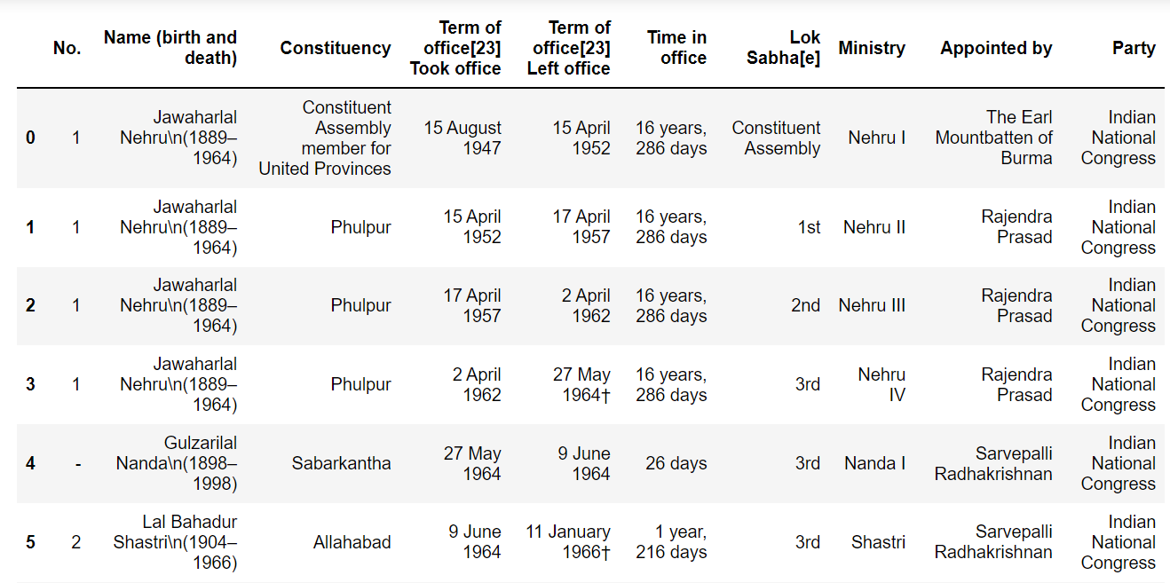
INTRODUCTION
India attained independence on August 15th, 1947, with Independence came our own government for the first time which in turn led to us having a Prime Ministers for the first time ever.
This data set includes all the information of the preceding Prime Ministers to the prime Ministers to date. INDIA has had 15 different Prime Ministers and 10 different Parties holding office in the last 75 years of Independence

Slide 3
OBJECTIVE OF PROJECT
1) The primary objective of the project was to Explore the data set by:
Perform cleaning of data
Analyzing the data
Visualize the data
2) Through EDA, understand the insight about duration of holding office of various prime ministers of INDIA.

Slide 4
ABOUT THE METHODOLOGY-EDA
Before existence of Data Science, analyzing data used to be hectic task and existing system didn't used to analyses the data with perfection.
Without existence of current cutting-edge technology of data science, we can get actionable insights in the dataset of the Indian Trade.
Following are the benefits which weren't present in the existing system of data analysing:
Making Better Decision with The Help of Data
Directing actions based on trends- which later defines the goals required for profit.
Doing challenging stuffs with the help of prediction which is done by data.
Identifying various opportunities to increase the profit
Making decision with Quantifiable, data driven evidence so that loss doesn't happens.
Testing the decisions taken by the data and watching and analysing the trend.

Slide 5
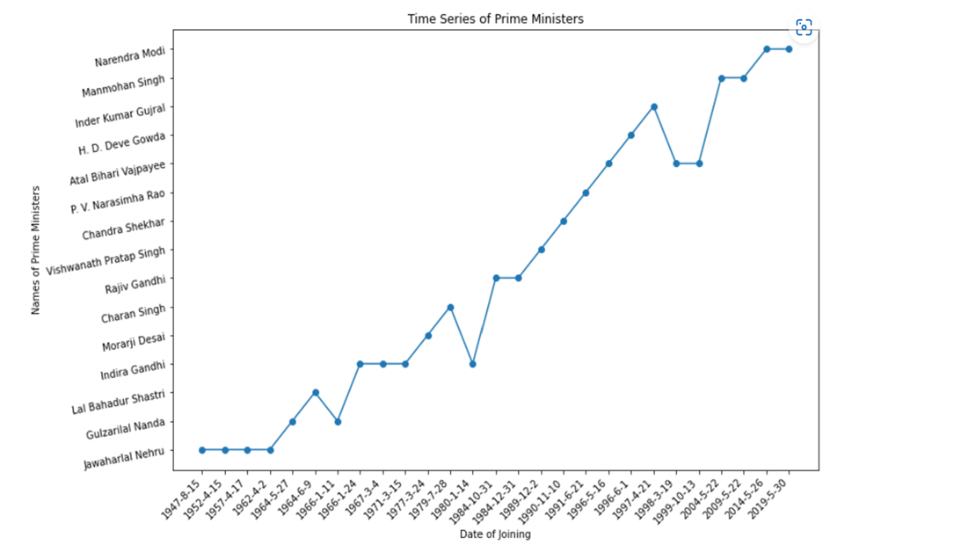
ANALYSIS OF DATASET PLOTS
1)Time Series Plot Of Prime Ministers Of India:
A)Introduction:- This plot shows the Time Series of Prime Ministers(the order in which they have succeeded each other.)
B) Specific Requirements/Functions
and Formulas:
Data Set of Prime Ministers
Pandas module
Datetime module
Numpy module
Scatter plot from matplotlib.pyplot
C) Analysis Results:
Jawaharlal Nehru held office for 4
consecutive terms , the most any prime
minister has. Gulzarilal Nanda was the interim
Prime minister twice for a period of 13 days each.
Indira Gandhi holds the second longest
streak of holding office (3 consecutive terms).
Rajiv Gandhi, Atal Bihari Vajpayee,
Manmohan Singh and Narendra Modi have all held 2 consecutive terms.

Slide 6
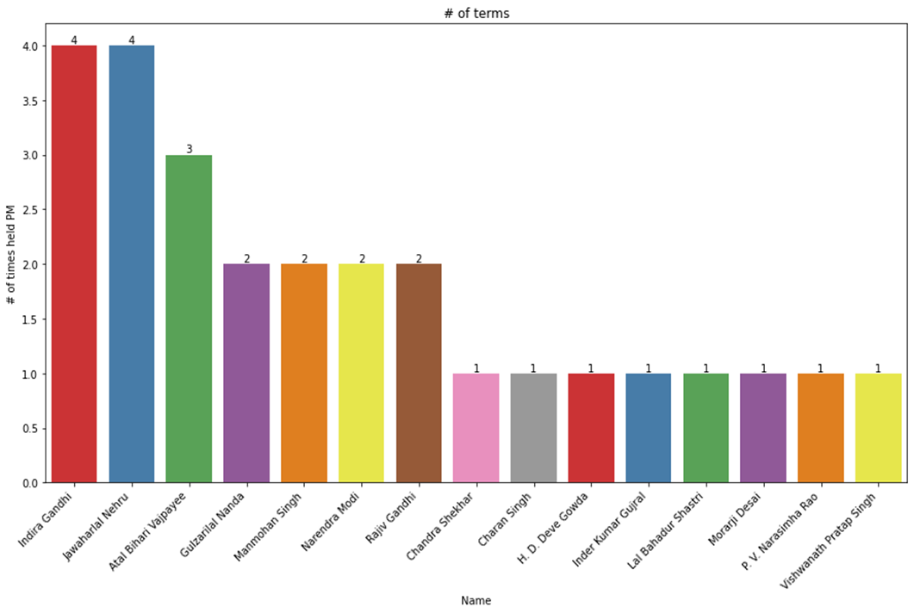
2) Frequency Plot Of all the Prime Ministers who have held office: A)Introduction: This plot shows the analysis of different Prime Ministers of INDIA.
B)Specific Requirements/Functions and Formulas:
Data set column of Name and Frequency Number
of Prime Ministers
Matplotlib module
Sort data in descending order.
Seaborn module.
C)Analysis Results:
Jawaharlal Nehru was the India’s longest serving Prime Minister who served for more than 16 years.
Gulrzarilal Nanda worked twice as the Acting Prime Minister for 13 days each.
Atal Bihari Vajpayee was the first parliamentarian to give a speech in hindi to the United Nations General Assembly.

Slide 7
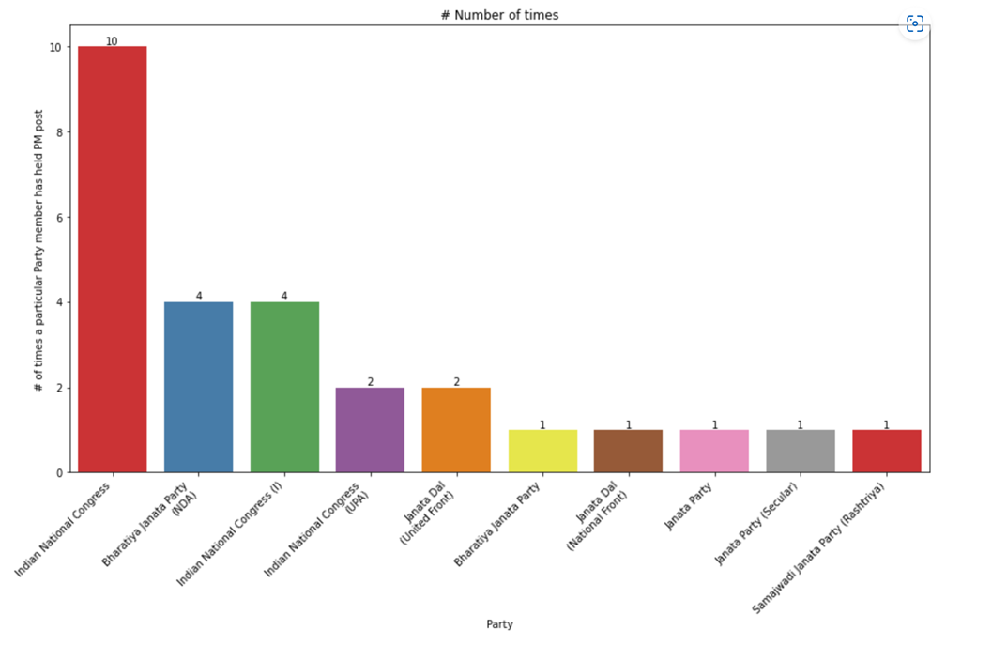
3) Frequency Plot of Parties who have been in Power
A)Introduction: This plot shows the number of times all parties who have had a Prime Minister from their Party.
B)Specific Requirements/Functions and Formulas:
Data set column of ‘Party’ and Frequency Number
of Prime Ministers
Matplotlib module
Sort data in descending order.
Seaborn module.
C)Analysis Results:
Indian National Congress has been the most
influential party in the history of India by
contributing 4 Prime Ministers who
have held a total of 10 terms.
The second position is held by BJP who have
contributed 2 Prime Ministers who have
held 2 terms each.

Slide 8
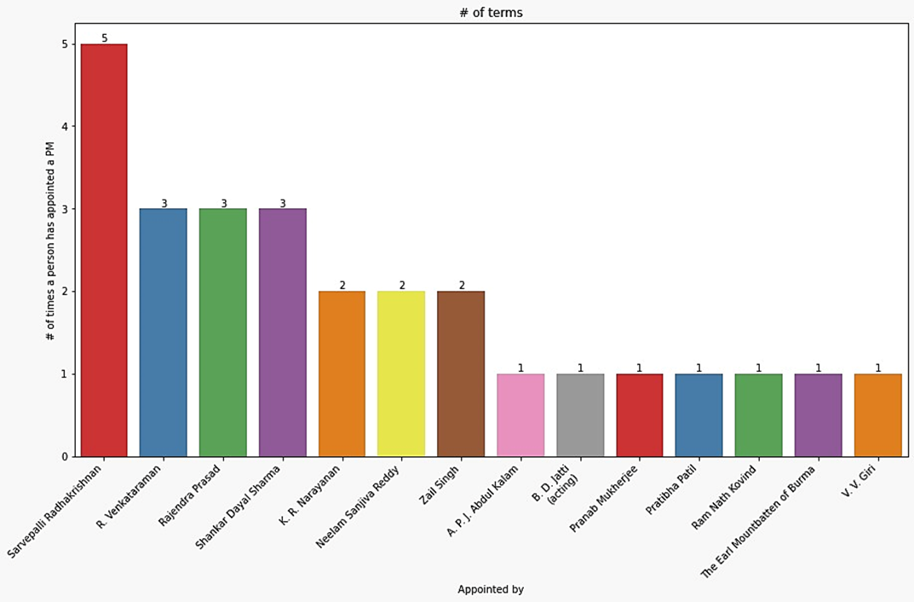
4) President who appointed the prime minister
A) Introduction: The analysis shows that the president appointed more prime ministers.
B) Specific Requirements/Functions and Formulas:
Data of Appointed by
With the help of a data bar chart is plotted.
C) Analysis Results:
Sarvepalli Radhakrishnan appointed more
prime ministers than others.
Rajendra Prasad, Shankar Dayal Sharma, and R. Venkataraman appointed 3 prime ministers.
Zail Singh, K. R. Narayanan, and Neelam Sanjiva Reddy appointed 2 prime ministers.

Slide 9
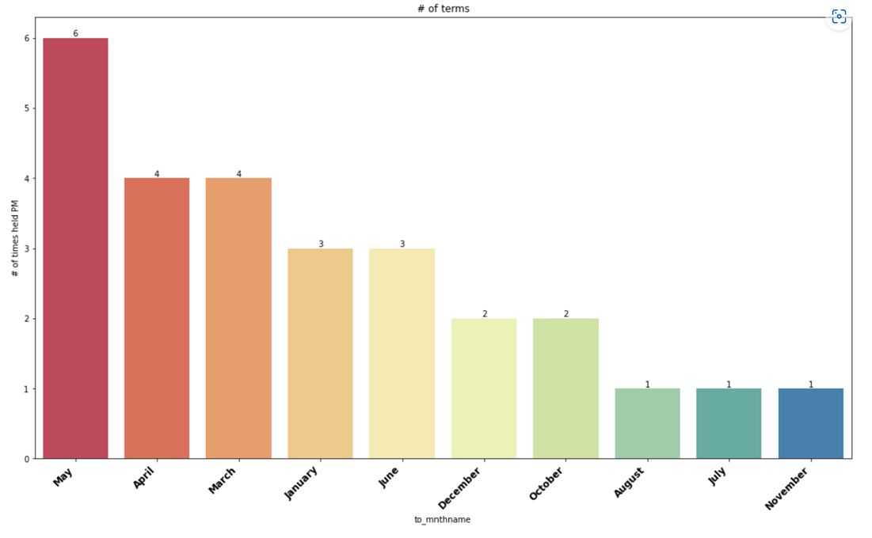
5)Times held PM in Particular Month
A) Introduction: The analysis shows number of times held PM In months.
B) Specific Requirements:
Data in month
With the help of data Bar Chart is plotted.
C) Analysis Results:
In May it holds the record of 6 times PM is
appointed in this month.
April and March are the months that holds the
record of 4 times PM has appointed.
December and October holds the record of 2 time
in a month.
August, July, November are the months that holds 1 time in month.

Slide 10
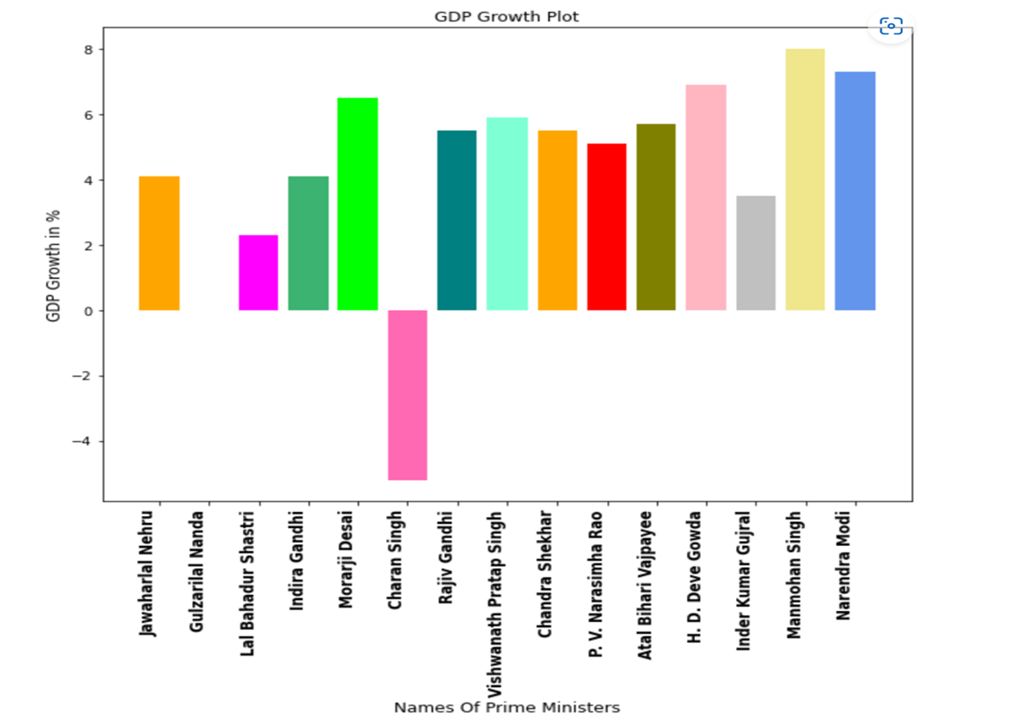
6)Growth of GDP
A) Introduction :- This analysis is all about the GDP growth which took place under the rule of different pm.
B)Specific requirements/Functions
and formulas:-
•GDP growth during each prime minister
•With the help of data bar chart is plot
C)Analysis report:-
Manmohan Singh was 13th prime
minister and India has seen by far the
highest growth in GDP during his section.
Jawaharlal Nehru was first pm of India
and during his time India has seen growth
of 4.1% .Because India got independence
during his time and India has also fought war.
Charan Singh is the only PM who has seen
growth in negative and major reasons are known
to be drought and Iranian revolution which led
to increase in oil prices.

Slide 11
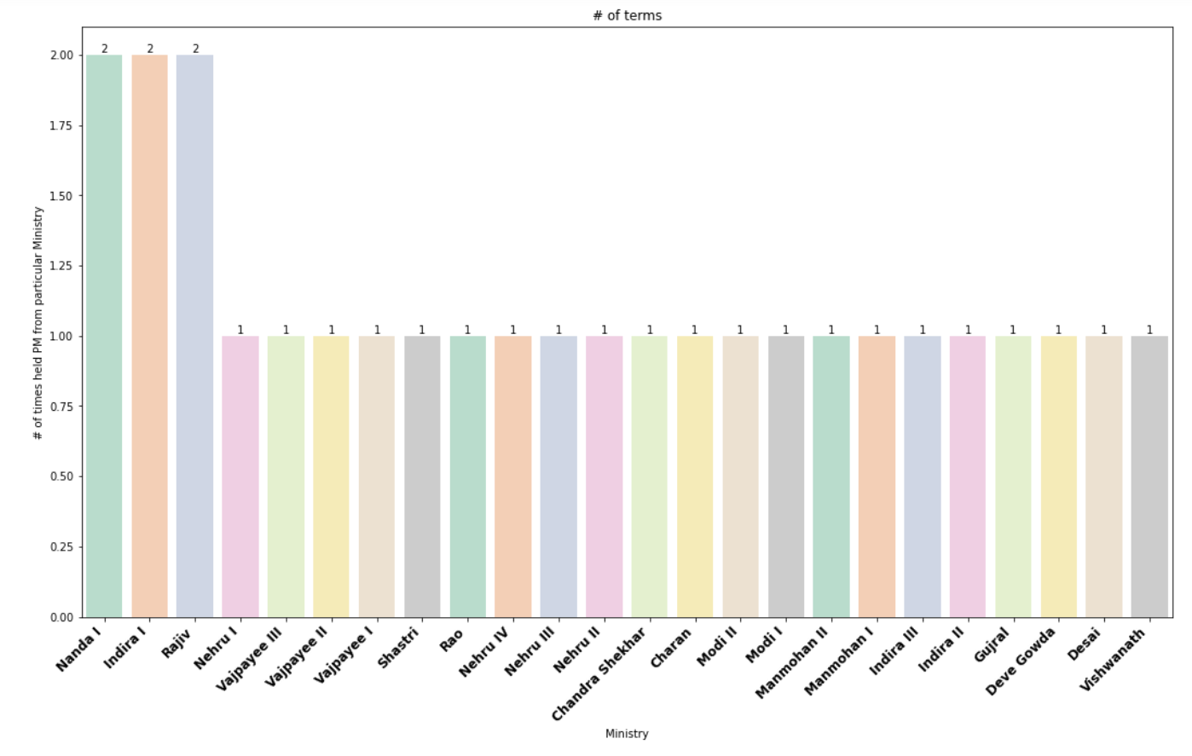
7) Times held PM from particular Ministry:
A) Introduction: The analysis shows how many times a particular ministry became prime minister.
B) Specific Requirements/Functions and Formulas:
Data of ministry
With the help of data Bar chart is plotted.
C) Analysis Results:
Nanda I , Indira I and Ravji held 2 times.
All others held for 1 time.

Slide 12
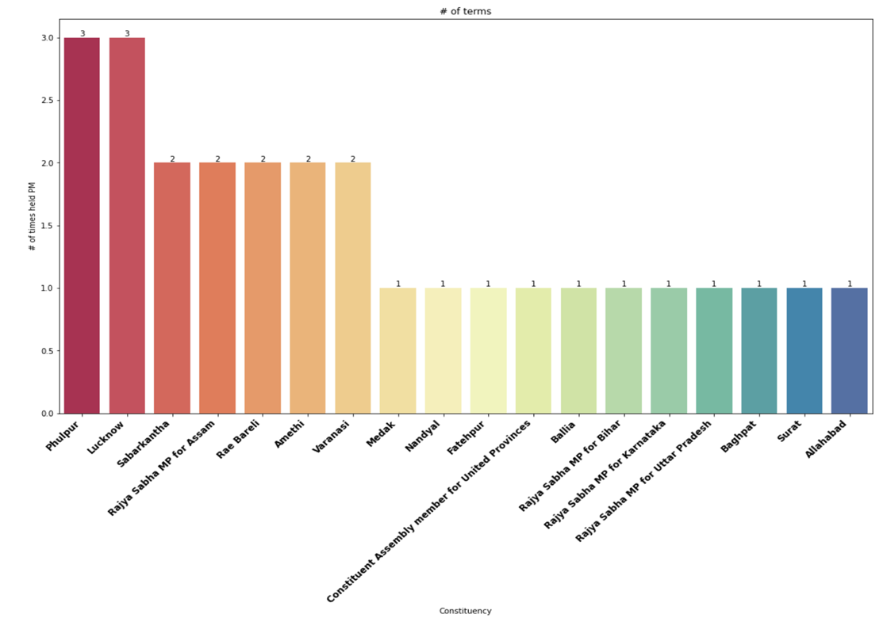
8)Number of Times Prime Minister has been appointed from a Constituency
A) Introduction: The analysis shows number of times held PM from that region.
B) Specific Requirements:
Data from Data Frame of column ‘Constituency’
With the help of data Bar Chart is plotted.
C) Analysis Results:
The total number of constituencies in India
are 543 out of which only 18 constituencies have
had representatives holding the post of the
Prime Minister.
Phulpur and Lucknow have had 1 Prime
Ministers holding 3 terms each , which is the
maximum amount of terms held from
a single constituency.

Slide 13
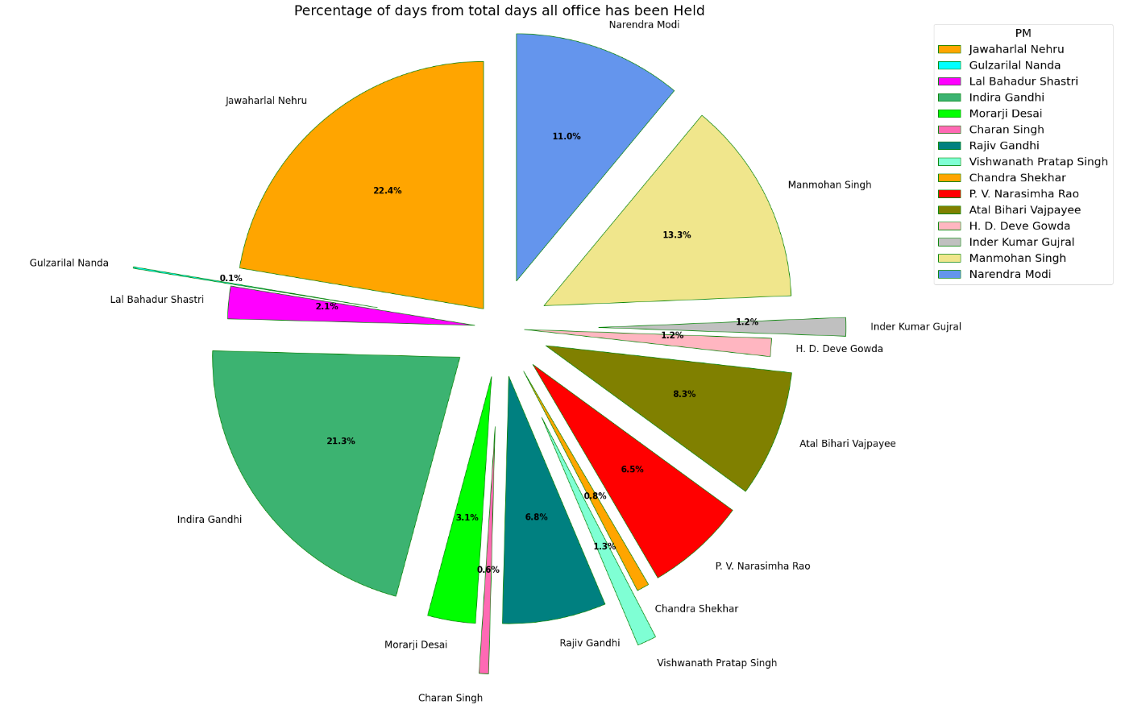
9) Time in office:
A) Introduction: The analysis shows the total time in office as per prime minister.
B) Specific Requirements/Functions and Formulas:
Data of time in office
With the help of data pie chart is plotted.
C) Analysis Results:
Jawaharlal Nehru, Lal Bahadur Shastri, and Indira Gandhi all died in time in office.
Jawaharlal Nehru’s time duration was much longer than others, taking 22.4%.
Gulzarilal Nanda’s duration was the lowest at 0.1%.

Slide 14
Conclusions
1.Over 75 years of independence we have seen the government and country of India flourish and grow with the Prime Ministers leading us from the front.
2. India has had 15 Prime Ministers who have held office for different time periods.
3. There have been representations of 17 constituencies.
4.There have been 14 presidents who have appointed the Prime Ministers.
5.There have been a total of 10 Parties who have held office some of which were modifications of the older parties.
6.The Indian National congress along with Bhartiya Janata Party have majorly led India to what it is today.
7.Nehru was the First Prime Minister of India and held office with solidarity for a total of 4 terms.

Slide 15
8.Indira Gandhi matches Nehru’s time in ways of Terms held in office.
9.Gulzarilal Nanda held office for the least time which was 13 days each after Nehru and Lal Bahadur Shastri
10.Manmohan Singh had the highest GDP growth while Charan Singh had the lowest and was also the only one to have a negative GDP.
By this we would like to conclude,
We have explored the information of Prime Ministers from the Dataset given to us and with sheer determination have tried to analyze the data and infer the information in the best way possible by means of plotting Charts and Graphs.

Slide 16
Reference
[1] https://www.theweek.in/news/india/2019/01/26/republic-day-special-15-indian-prime-ministers-achievements.html
[2] https://en.wikipedia.org/wiki/List_of_prime_ministers_of_India

Slide 17
!! THANK YOU !!
｡^‿^｡

